Slide 1
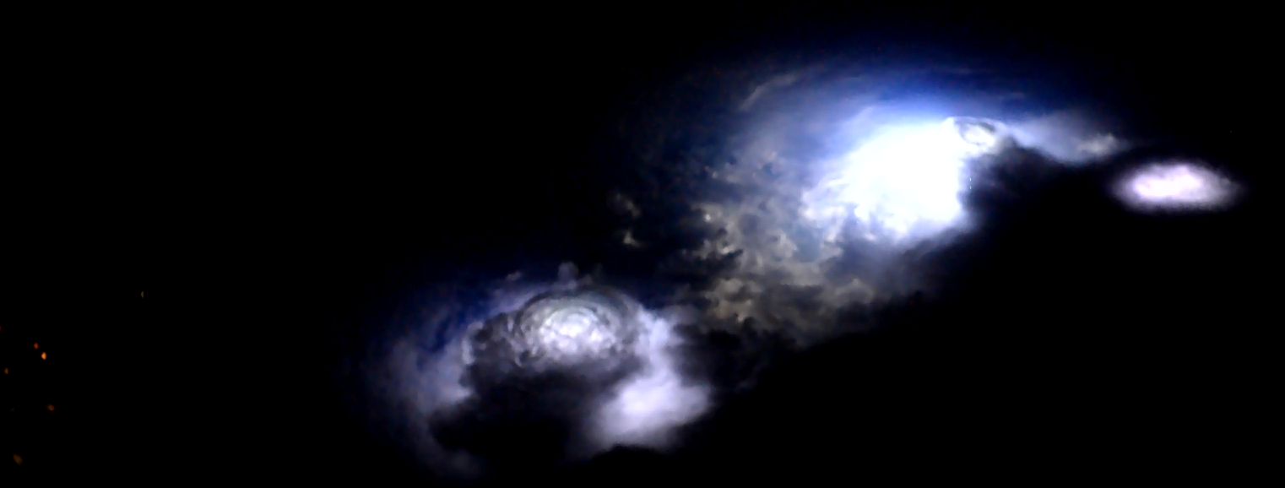

SAINT
Science and Innovation
With Thunderstorms
SAINT
H2020 Marie Skłodowska-Curie Initial Training Network

Slide 2
SAINT
SAINT

Slide 3

H2020 Marie Skłodowska-Curie
Initial Training Network

Slide 4


Science and Innovation With Thunderstorms
SAINT
H2020 Marie Skłodowska-Curie
Initial Training Network

Slide 5
Science and Innovation With Thunderstorms
SAINT
H2020 Marie Skłodowska-Curie
Initial Training Network

Slide 6
SAINT
Science and Innovation With Thunderstorms
H2020 Marie Skłodowska-Curie Initial Training Network

